Slide 1
PartyTech
Marissa Miller, Kikito Meraz, Bryn Loftness, Brandon Ward

Slide 2
1/10

Slide 3
4/10

Slide 4
PartyTech
Marissa Miller, Kikito Meraz, Bryn Loftness, Brandon Ward

Slide 5
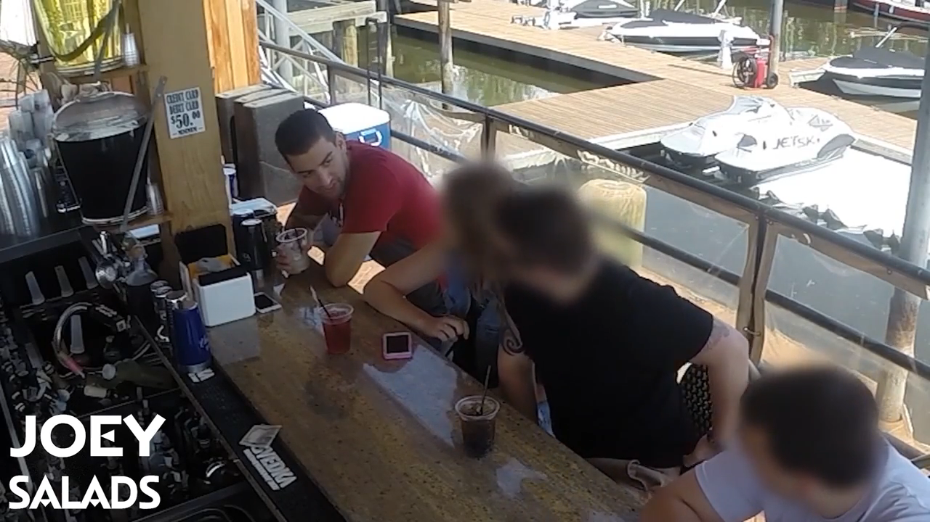

Slide 6
PartyTech
Marissa Miller, Kikito Meraz, Bryn Loftness, Brandon Ward

Slide 7
Party Cup

Slide 8
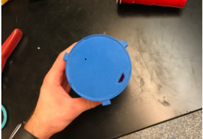
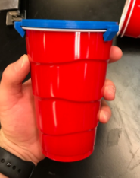
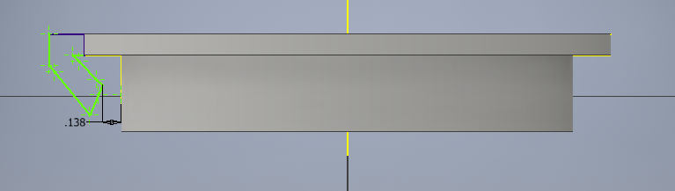
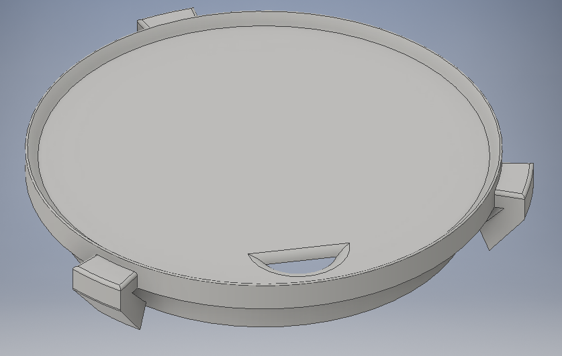

Slide 9
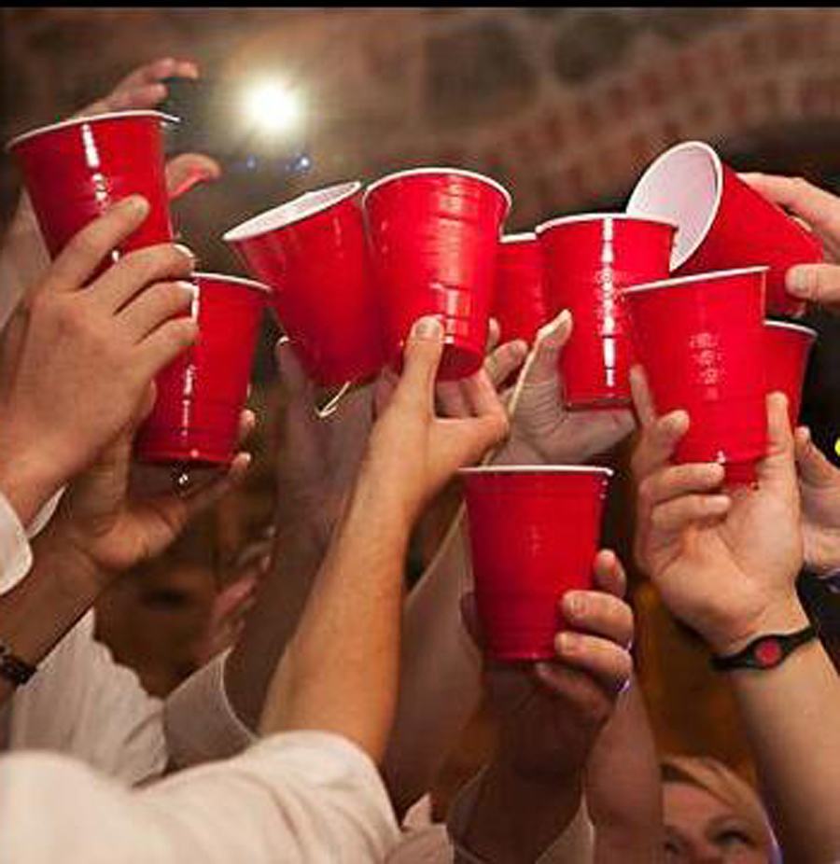

Slide 11
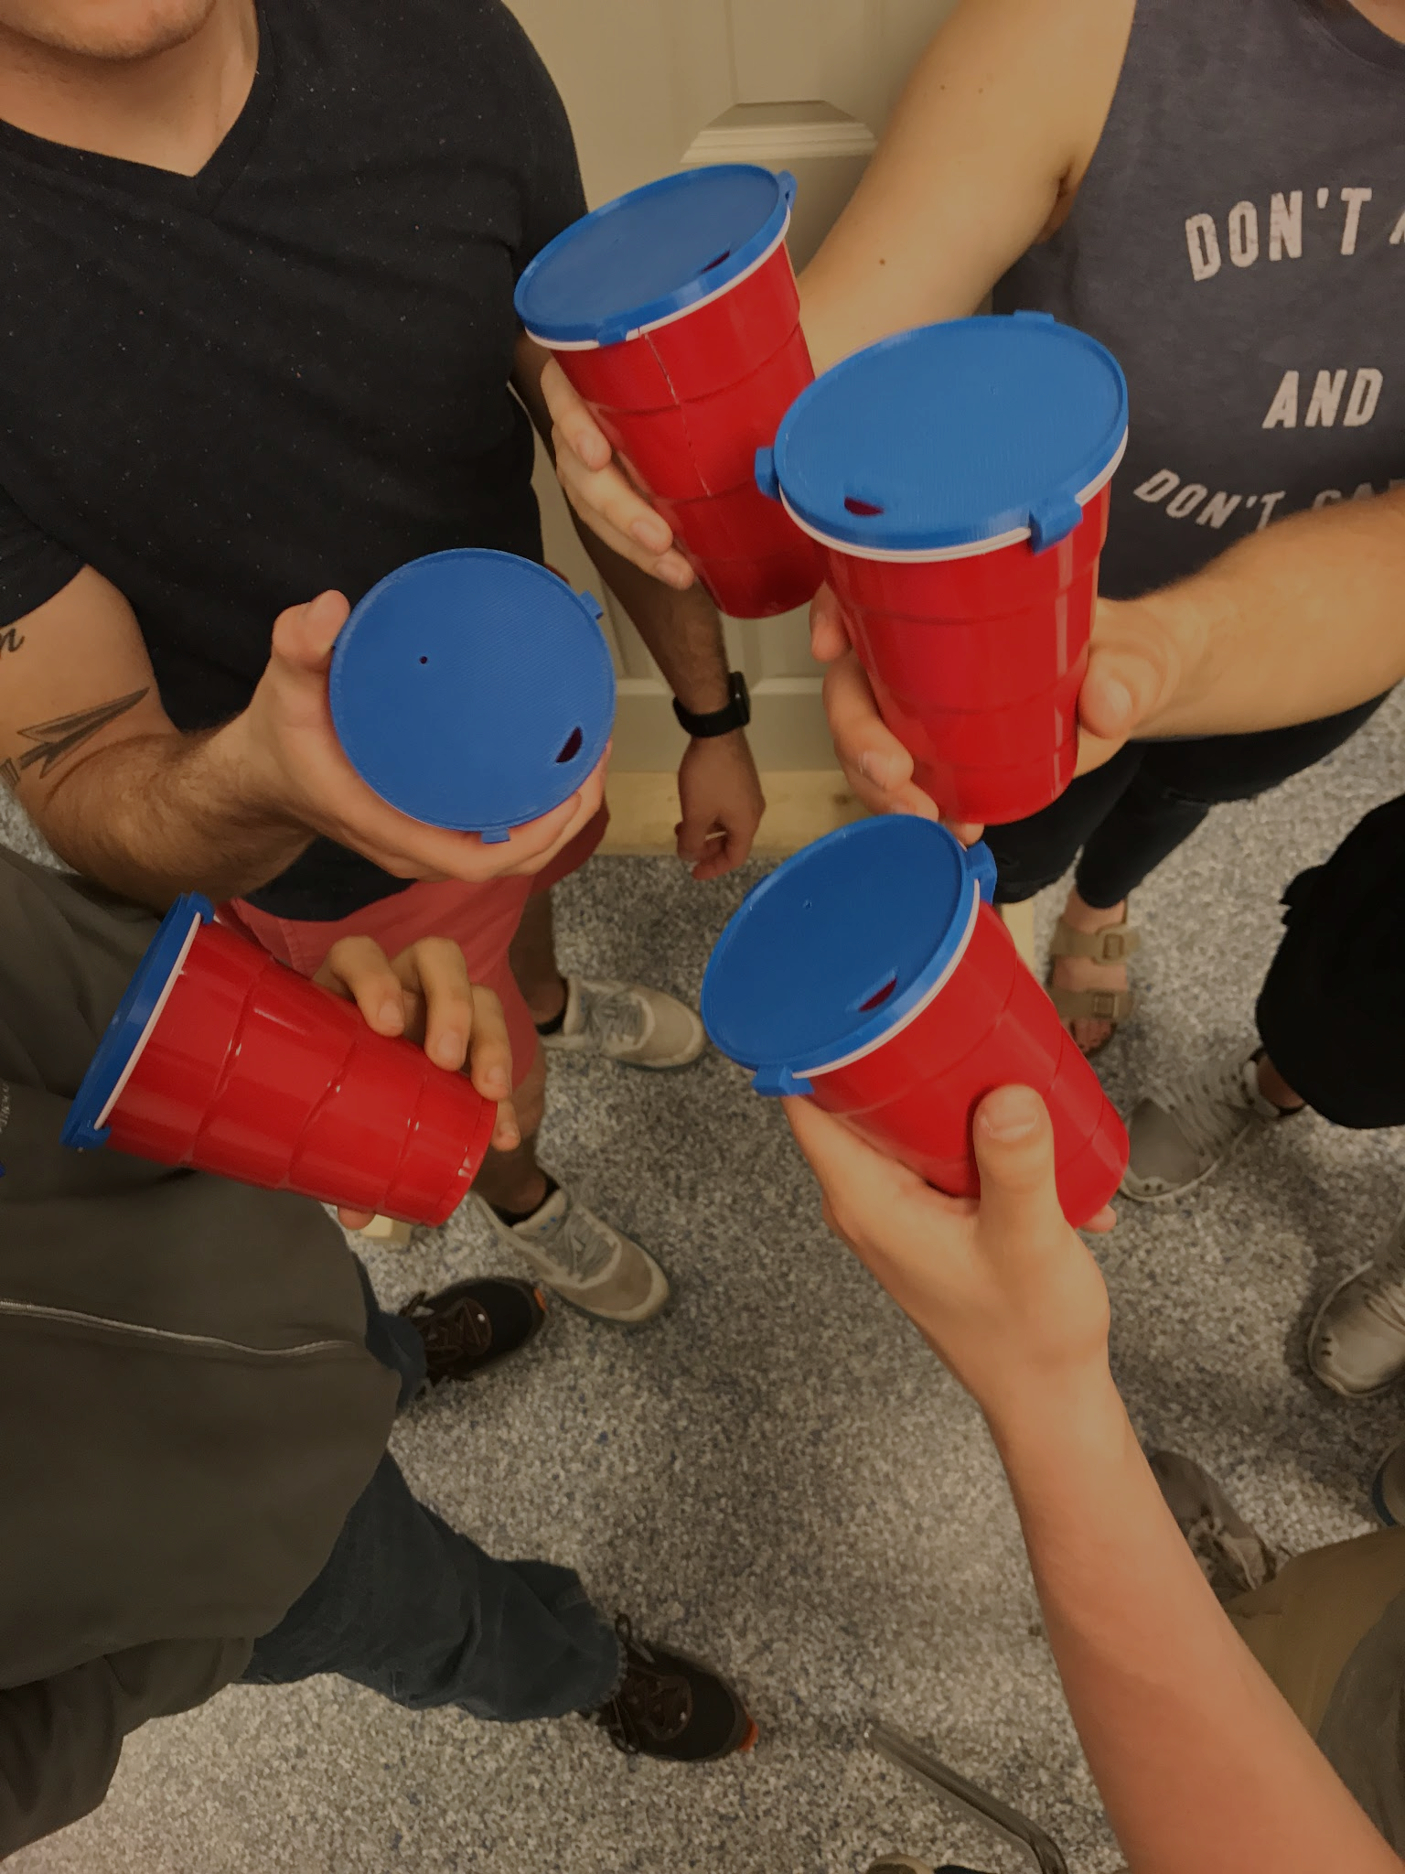

Slide 12
Party Cup

Slide 13
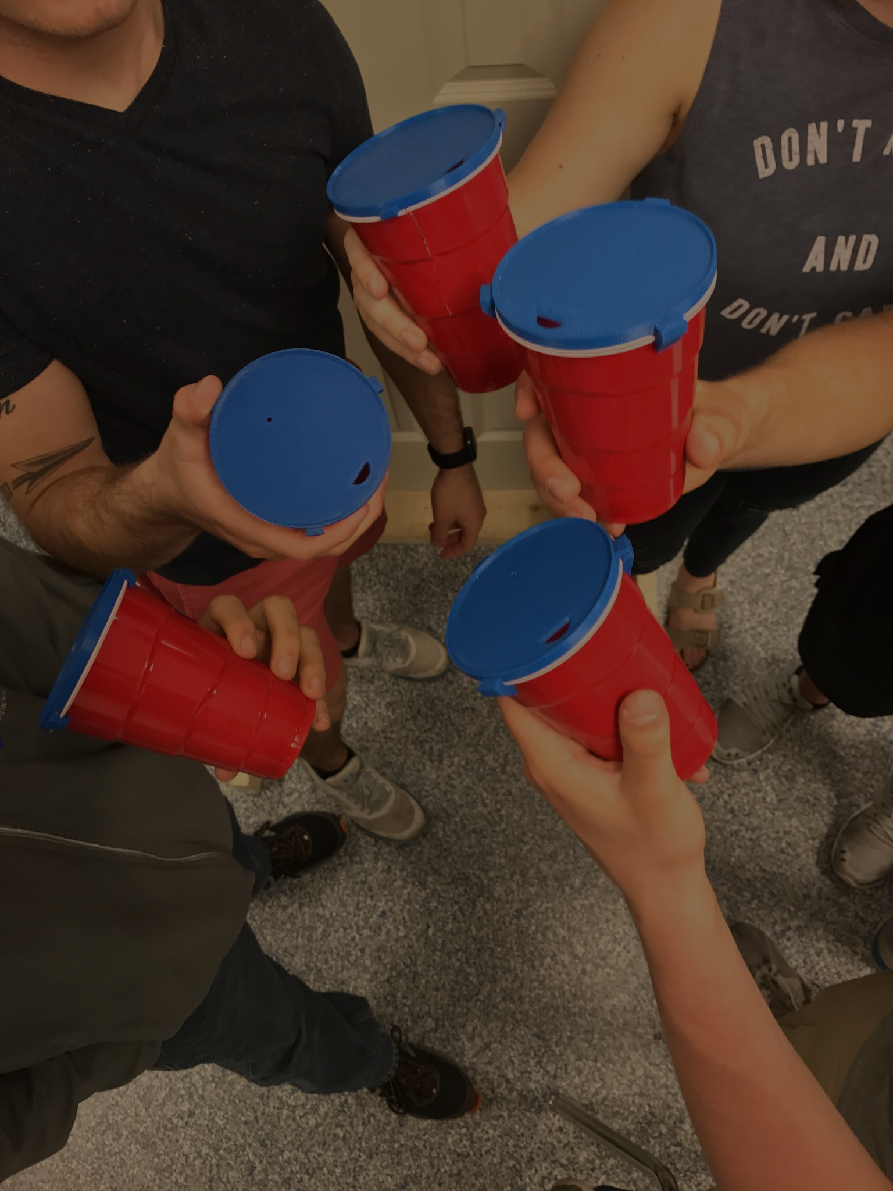
3D Printed
“Fish-Hook” Corner
Leak Proof
Protects Against Drink Spiking - Area<0.05 in²
Limits Alcohol Intake
Secure Lid

Slide 14
PartyTech
Marissa Miller, Kikito Meraz, Bryn Loftness, Brandon Ward

